Slide 1
Communications in Organizations

Slide 2
Definition
The communication is a process, when a person, group or organization (sender), transmits information (message), to another person, group or organization (recipient).

Slide 3
Coding
Communication channels
Decoding
Feedback
Noise

Slide 4
Alexander Graham Bell Quotes:
Character: A man, as a general rule, owes very little to what he is born with - a man is what he makes of himself.
Focus: Concentrate all your thoughts upon the work at hand. The sun's rays do not burn until brought to a focus.
Achievements: What this power is, I cannot say. All I know is that it exists...and it becomes available only when you are in that state of mind in which you know exactly what you want...and are fully determined not to quit until you get it.
Overcoming Failure: When one door closes another door opens; but we often look so long and so regretfully upon the closed door, that we do not see the ones which open for us.

Slide 5
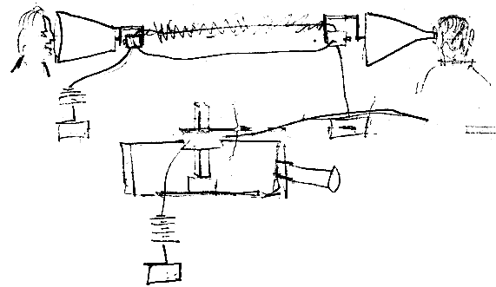
Picture by Alexander Bell

Slide 6
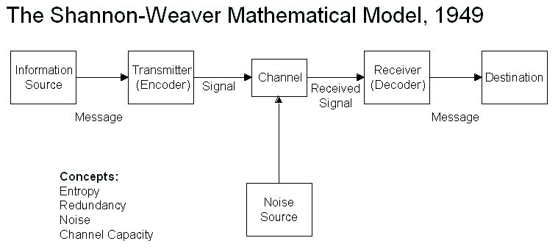
Notes:
Entropy: a measure of efficiency of a communication system (such as a code or a language) in transmitting information being equal to the logarithm of the number of different messages that can be sent by selection from the same set of symbols and thus indicating the degree of initial uncertaintythat can be resolved by any one message

Slide 7
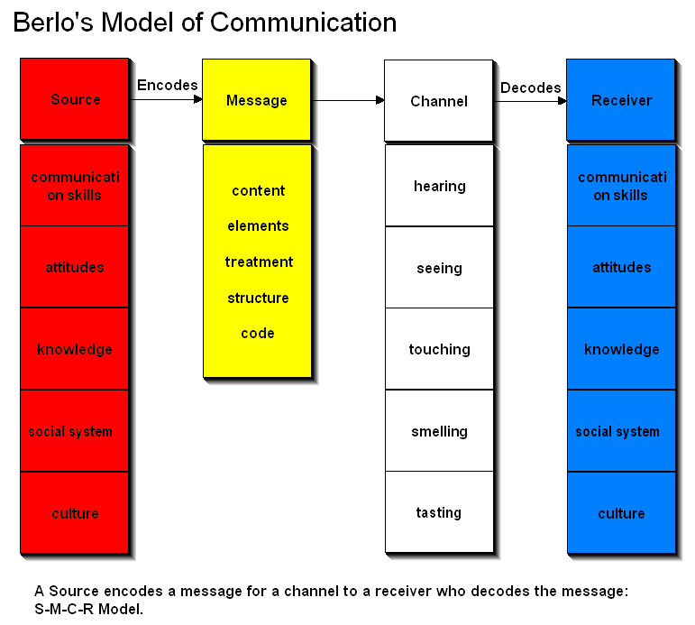

Slide 8
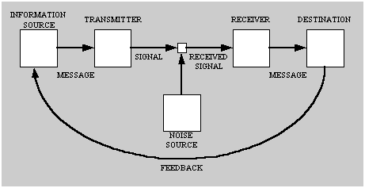
Interactive Model

Slide 9
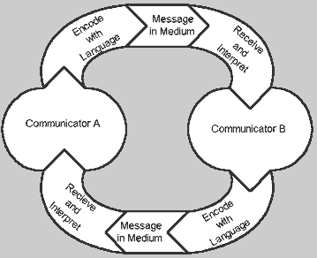
Transactional Model

Slide 10
The Role of Communication
Directs people towards desired behavior
Helps for coordination of the activities through systematic exchange of information.
The information is crucial for all organizational activities.
Interpersonal aspects - focused on people relationships.

Slide 11
Verbal and Non-verbal communication
Verbal communication – through words, said or written
Non-verbal communication – without words

Slide 12
How rich is a media?
Quantity of exchanged information
Level of personalization
Feedback availability

Slide 13
Traditional Verbal Media
Face-to-face discussions are rich:
Great volume of information is exchanged
High level of personalization
Provide immediate feedback
Not so rich interactive media without face-to-face contact, like telephone.

Slide 14
Poorer personal static media: messages, letters, sent either physically (letter) or electronically (faxes or electronic mail)
The poorest verbal media: non-personalized verbal media – advertisement leaflets and bulletins, addressed to a wider auditory.
Employee manuals

Slide 15
Electronic Communication
The electronic mail - the most popular means of computerized communication. 97% of the employees in USA and Canada use it every day.
Instant messaging
Real time file transfer
Video communication

Slide 16
Combining different means of communication
Combining of oral and written messages. Advantages.
Two-side or one-side communication
Clear and fuzzy messages

Slide 17
Nonverbal Communication
Communication through appearance – the way you dress
Who waits for whom
The position at the table
How is used the office space

Slide 18
The organizations also express aspects of their identity
They send messages via the way their space is used.

Slide 19
The men and the women communicate differently
They use the language in different way:
The men overestimate their status, the women underestimate it.
The women are focused on positive social relations creation.
The men usually use “I”, the women – “we”.

Slide 20
Cultural differences and communication
Words and gestures may mean different thinks for different people.
One word may have different meanings
The social situation may be misunderstood.
Work and travel abroad

Slide 21
Formal and informal communication in organizations
Formal communication
Informal communication

Slide 22
Organizational structure and communication
Top-down communication
Bottom-up communication
Horizontal communication

Slide 23
Informal Networks
There is no official restrictions on the information exchange.
Important due to the easy access.
Fast information exchange
Unite people with similar age, interests or experience.
There might be people from different level of the organization.

Slide 24
May get insulated from the management
Provide valuable source of information.
The informal communication is usually oral and can cross the boundaries of the organization.
Oral messages may lose their accuracy.
Nevertheless, the major part of the information transferred through the social networks is accurate.

Slide 25
Improving Communication Skills
Use simple, clear language.
Using unnecessary official language may create a serious barrier in communication
Using professional jargon + & -
Important principle: KISS – Keep It Short and Simple.

Slide 26
To be active, careful listeners
Listening is not a passive process
Asking questions and repeating ensures correct understanding.
Focus of the conversation without distracting.
Understanding entirely what is the topic before answering.

Slide 27
Identifying the elements
Hearing
Understanding
Remembering
Interpreting
Evaluating
Responding

Slide 28
The Good Listeners
Listen very carefully
Refrain from hostile attitude
Do not take a defensive position
Provide equal opportunities
Pay attention to people from all levels
Listen in a democratic way.
Listening skills are important management skills.
The good listeners progress rapidly in their careers

Slide 29
Effective communication with employees
Provide accurate and timely information
Give and seek feedback
Provide upward communication channels and motivate people to use them
Systems for proposals collection
About 15% of employees use the suggestion boxes, and about 25% of the proposals are implemented.

Slide 30
Informal meetings , “brown bag” lunches
Open sharing of ideas
Employees from different levels interact with corporate executives from higher levels in the hierarchy
Hotlines for employees
Polls when discussing key issues of the organization

Slide 31
Improve Relationships
The supportive communication helps the effective communication.
The supportive communication is:
Exact
Fair
Builds and improves relationships

Slide 32
Tactics for supporting communication
Focus on the problem, not on the person
Say honestly what you mean. People avoid difficult questions that mask their true thoughts.
Take responsibility for your decisions. Clarify of what you have done and how you feel.
Use positive tone. Avoid language and tone that could hurt interlocutor.
Keep on the conversation. So you can get additional information or confirmation of what was said by the interlocutor.

Slide 33
Tips for effective communication
Inspire confidence and power by emotionally charged words.
Instill credibility. Support your claims with irrefutable data.
Challenge interest in the listener with you message Make it particularly interesting and important.
Avoid parasitic words such as “look" and “well". Practice using a tape recorder.
Use direct messages. Start with the basic idea and use the rest of the message to illustrate and justify it.

Slide 34
